Slide 1
Employee Data Analysis using Excel
STUDENT NAME: PURUSHOTHAMAN .D
REGISTER NO:312219381&ASUNM1711312219381
DEPARTMENT: B.com (BANK MANAGEMENT)
COLLEGE: S.A. COLLEGE OF ARTS AND SCIENCE

Slide 2
PROJECT TITLE
Employee Performance Analysis using Excel

Slide 3


AGENda
Problem Statement
Project Overview
End Users
Our Solution and Proposition
Dataset Description
Modelling Approach
Results and Discussion
Conclusion
3/21/2024 Annual Review

Slide 4

PROBLEM STATEMENT
Current Situation: The company seeks to implement a fair and motivational bonus structure for its employees.
Challenge: Ensure that bonus distribution aligns with the company's equity principles and rewards outstanding performance.

Slide 5

PROJECT OVERVIEW
Objective: Establish a structured bonus system that acknowledges and rewards for the efforts of staff members.
Scope: This project involves defining and communicating the bonus amounts and ensuring the process is transparent and equitable.

Slide 6

WHO ARE THE END USERS?
Target Audience: Male and female staff members across all departments.
Impact: Employees will understand the bonus distribution criteria and feel valued for their contributions.

Slide 7

OUR SOLUTION AND ITS VALUE PROPOSITION
Rationale: This structure aims to recognize and incentivize performance while also addressing potential gender-related compensation disparities.
Proposed Bonus Structure:
JOB RATING | BONUS
5 | 6000
4 | 5500
3 | 5000
2 | 4500
1 | 4000

Slide 8
Dataset Description
Employee Data Set = Edunet Dashboard
9 Feature they are provided.
5 features are taken to data analysis
They are:
Emp Id = Value & Number
Name = Text
Gender = Male, Female
Employee Rating = numerical value
5. Bonus =
JOB RATING | BONUS
5 | 6000
4 | 5500
3 | 5000
2 | 4500
1 | 4000

Slide 9

THE "WOW" IN OUR SOLUTION
=IF(J2=5,5000,IF(J2=4,5500,IF(J2=3,5000,IF(J2=2,4500,IF(J2=1,4000)))))
3/21/2024 Annual Review
9

Slide 10
MODELLING
COLLECTION OF DATA SET :
The data was collected from the edunet dash board
And all the data was alignment and there are 7 features are given
In these 7 features as that I was selected the 3 features to analysis the employee rating form the employee data base.
FEATURES COLLECTING:
In the data base their was an blank cell are in the data
To remove the blank cell first used the conditional formatting tool used to highlight the black cell with the filling of color
10

Slide 11
After filling with the color of the blank cell .
With the help of the slicer & filter option removed the blank row and color in the dataset.
DATA HIGHLIGHTING:
In the given 7 features we have to highlight the feature which we have to analysis the date
Emn Id, name, gender, employee type , increment amount.
RATING LEVEL CALCULATION:
The increment amount are calculated by the formula of=IF(J2=5,5000,IF(J2=4,5500,IF(J2=3,5000,IF(J2=2,4500,IF(J2=1,4000)))))
The value of bonus is based on gender if employee

Slide 12
PIVOT TABLE:
In the pivot table they are used to summarize the data which are provided in the data set.
The important column are selected in the pivot table are Emn Id, name, gender, employee type, increment amount.
They are customize in the pivot table option
Bonus =Rows
Gender= Column
Name= Filter
Count of job rating= Values
GRAPH CHART :
In the analysis the important thing we have to insert the graph chart .
The recommended chart we can select the data are shown in the data.

Slide 13
In the graph chart they are shown the trend line of the data set which we have selected in the table
In all the data are selected and we have to name the graph chart of the data “ bonus amount of employee on salary”
each and every line and diagram are provided in the chart
SLICER& FILTER:
in the slicer and filter they are provided the summarizing the data in the short list.
In these are provided under the heading are in the greater of the option .
After selecting the dialogue box the new box will appear and select which data are used to provided under the pivot table.
The data are provided in the pivot table , graph chart, slicer.

Slide 14
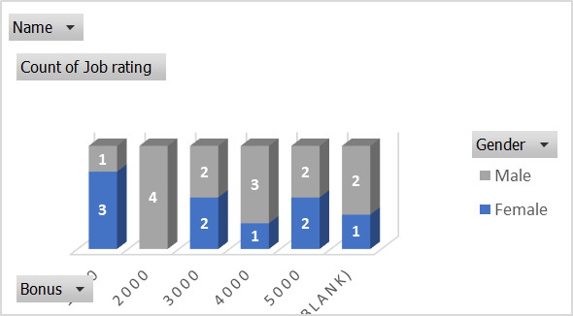
RESULTS
14

Slide 15
FINDINGS
Findings:Equity Considerations: The proposed bonuses aim to address and enhance overall employee fulfilment.
Impact Assessment: Initial feedback and analysis suggest that the proposed bonus amounts are well-received and align with performance expectations.

Slide 16
conclusion
Summary: Implementing a bonus structure aligns with company goals of fair compensation and performance recognition like( job rating 5 =6000,job rating 4=5500,job rating 3=5000,job rating 2=4500,job rating 1=4000)
Communication Plan: Clearly communicate the new bonus structure to all employees.
Feedback Mechanism: Establish a process for collecting employee feedback and addressing any concerns.

